Slide 1
Support and Command Center (SCC)
Presented by:
Dolot, Patrick Vonn
Rivera, Mark Jerome
Cayaban, Francis Paolo

Slide 2
Main Objective
Document all incident reports and activities in calls made in a call center.
To have a record of all technical and transmission issues with the automated election.
To promote integrity for election return transmission.

Slide 3
Problem Statement
Previous system had issues with transmission logs.
Previous system had unsynchronized timestamp
Previous system does not have reports for transmission issues and incident reports.

Slide 4
Project Overview
The Support and Command Center (SCC) is a Web-based application that aims to provide a Logging System that will support the support center processes namely :
Registration of all BEI and BOC
Document and note technical support calls
Transmission confirmation for election returns to the Board of Canvassers
The said project will serve as an evidence after the election if there will be a protest against the results of the election.

Slide 5
Scope and Limitation
Will create call documentation using text files
Will be limited to 5 users namely
Administrator
Registrar
Team Leader
Agent (Call center agent)

Slide 6
Who would benefit from the system?
Electoral Candidates
Voters
Philippines

Slide 7
Modules
User Creation
BEI/BOC profile registration
Ticket and Case creation

Slide 8
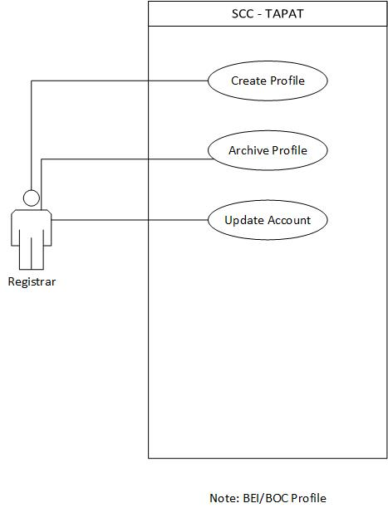
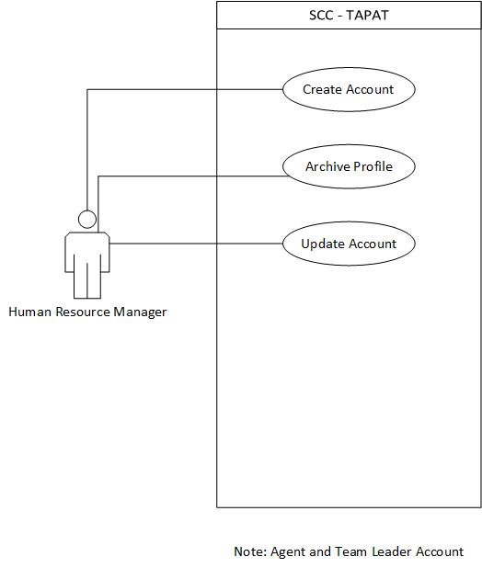
Use Case

Slide 9
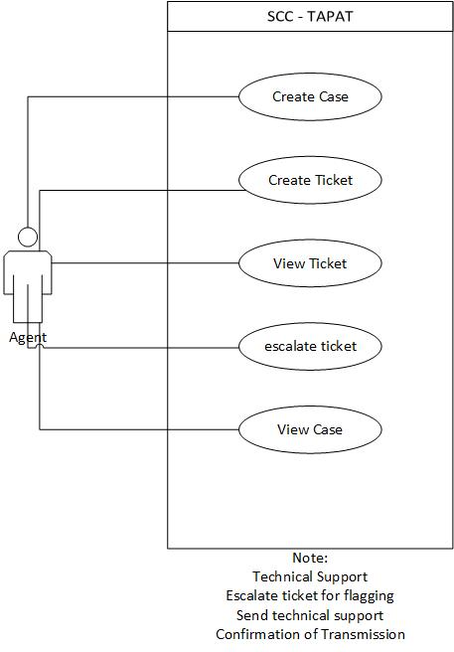
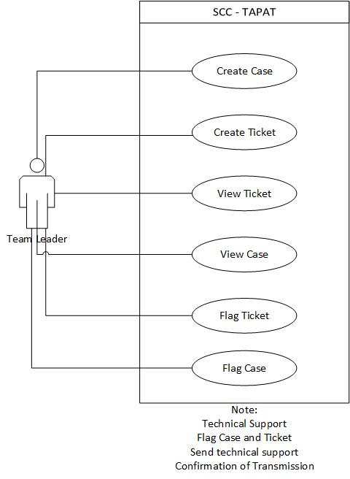
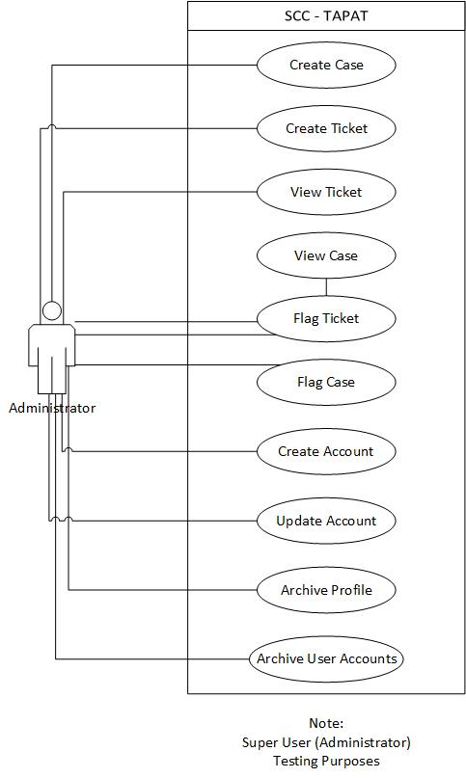
Use Case

Slide 10
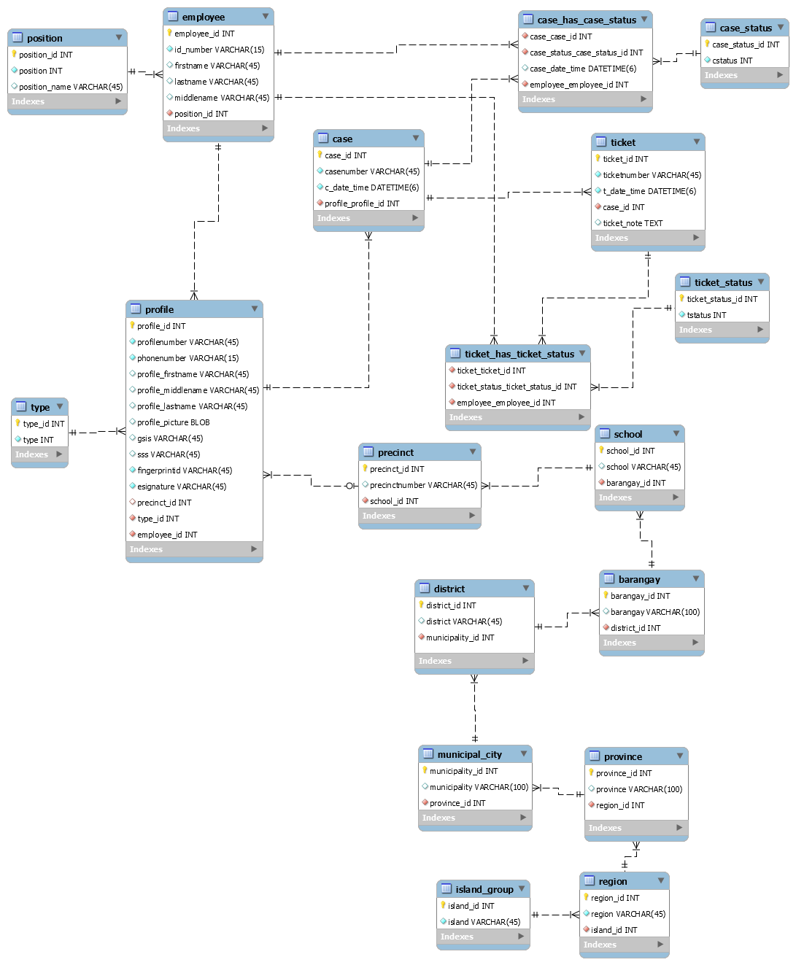
ERD

Slide 11
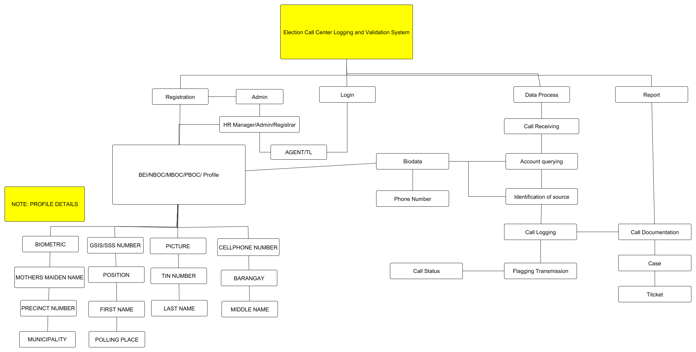
Site map

Slide 12
Reference
Republic Act 9369
Comelec Resolution no. 8879
Comelec Resolution no. 8900

